Slide 1
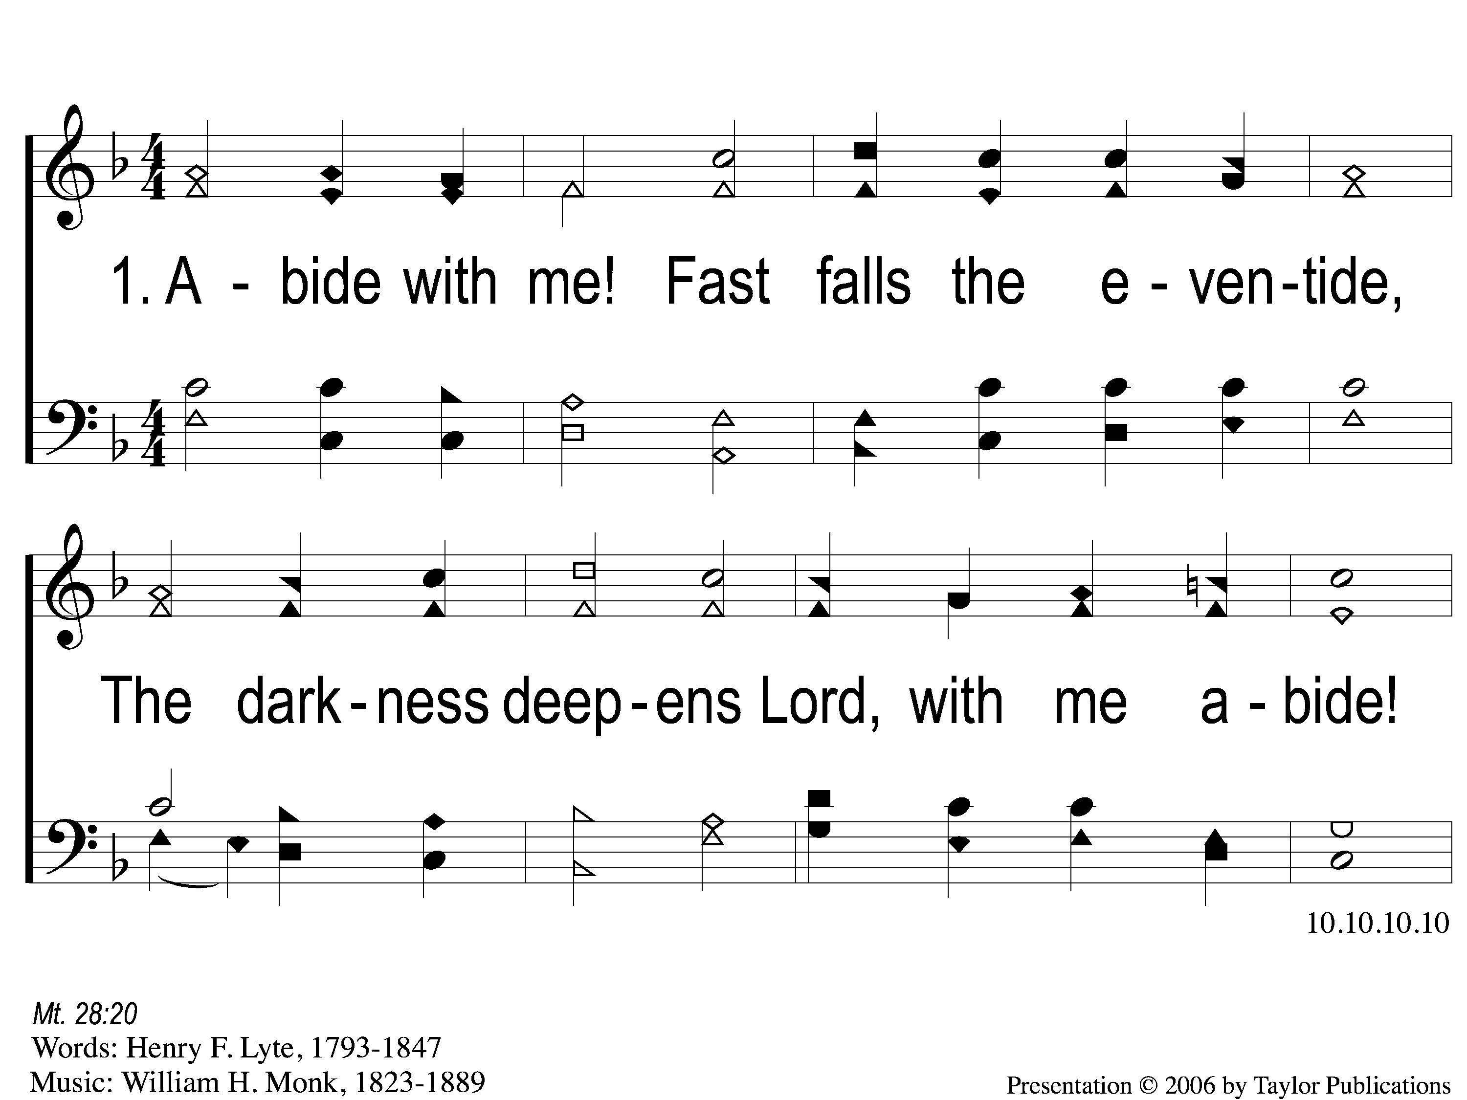
1-1 Abide with Me
Abide With Me
19

Slide 2
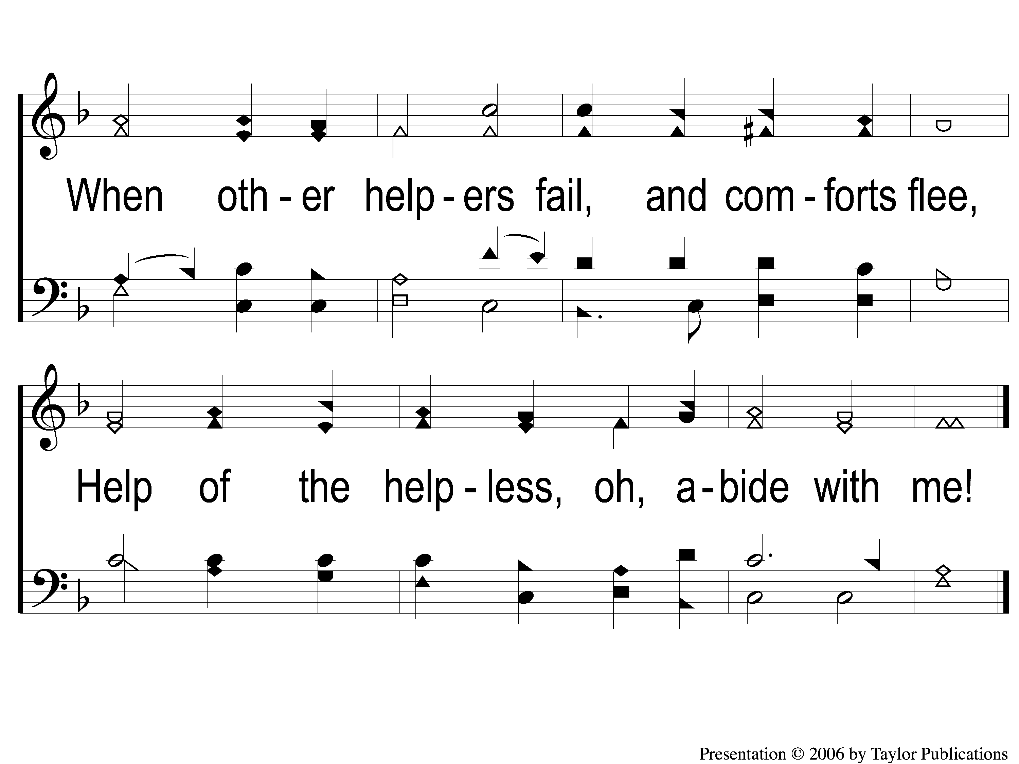
1-2 Abide with Me
Abide With Me
19

Slide 3
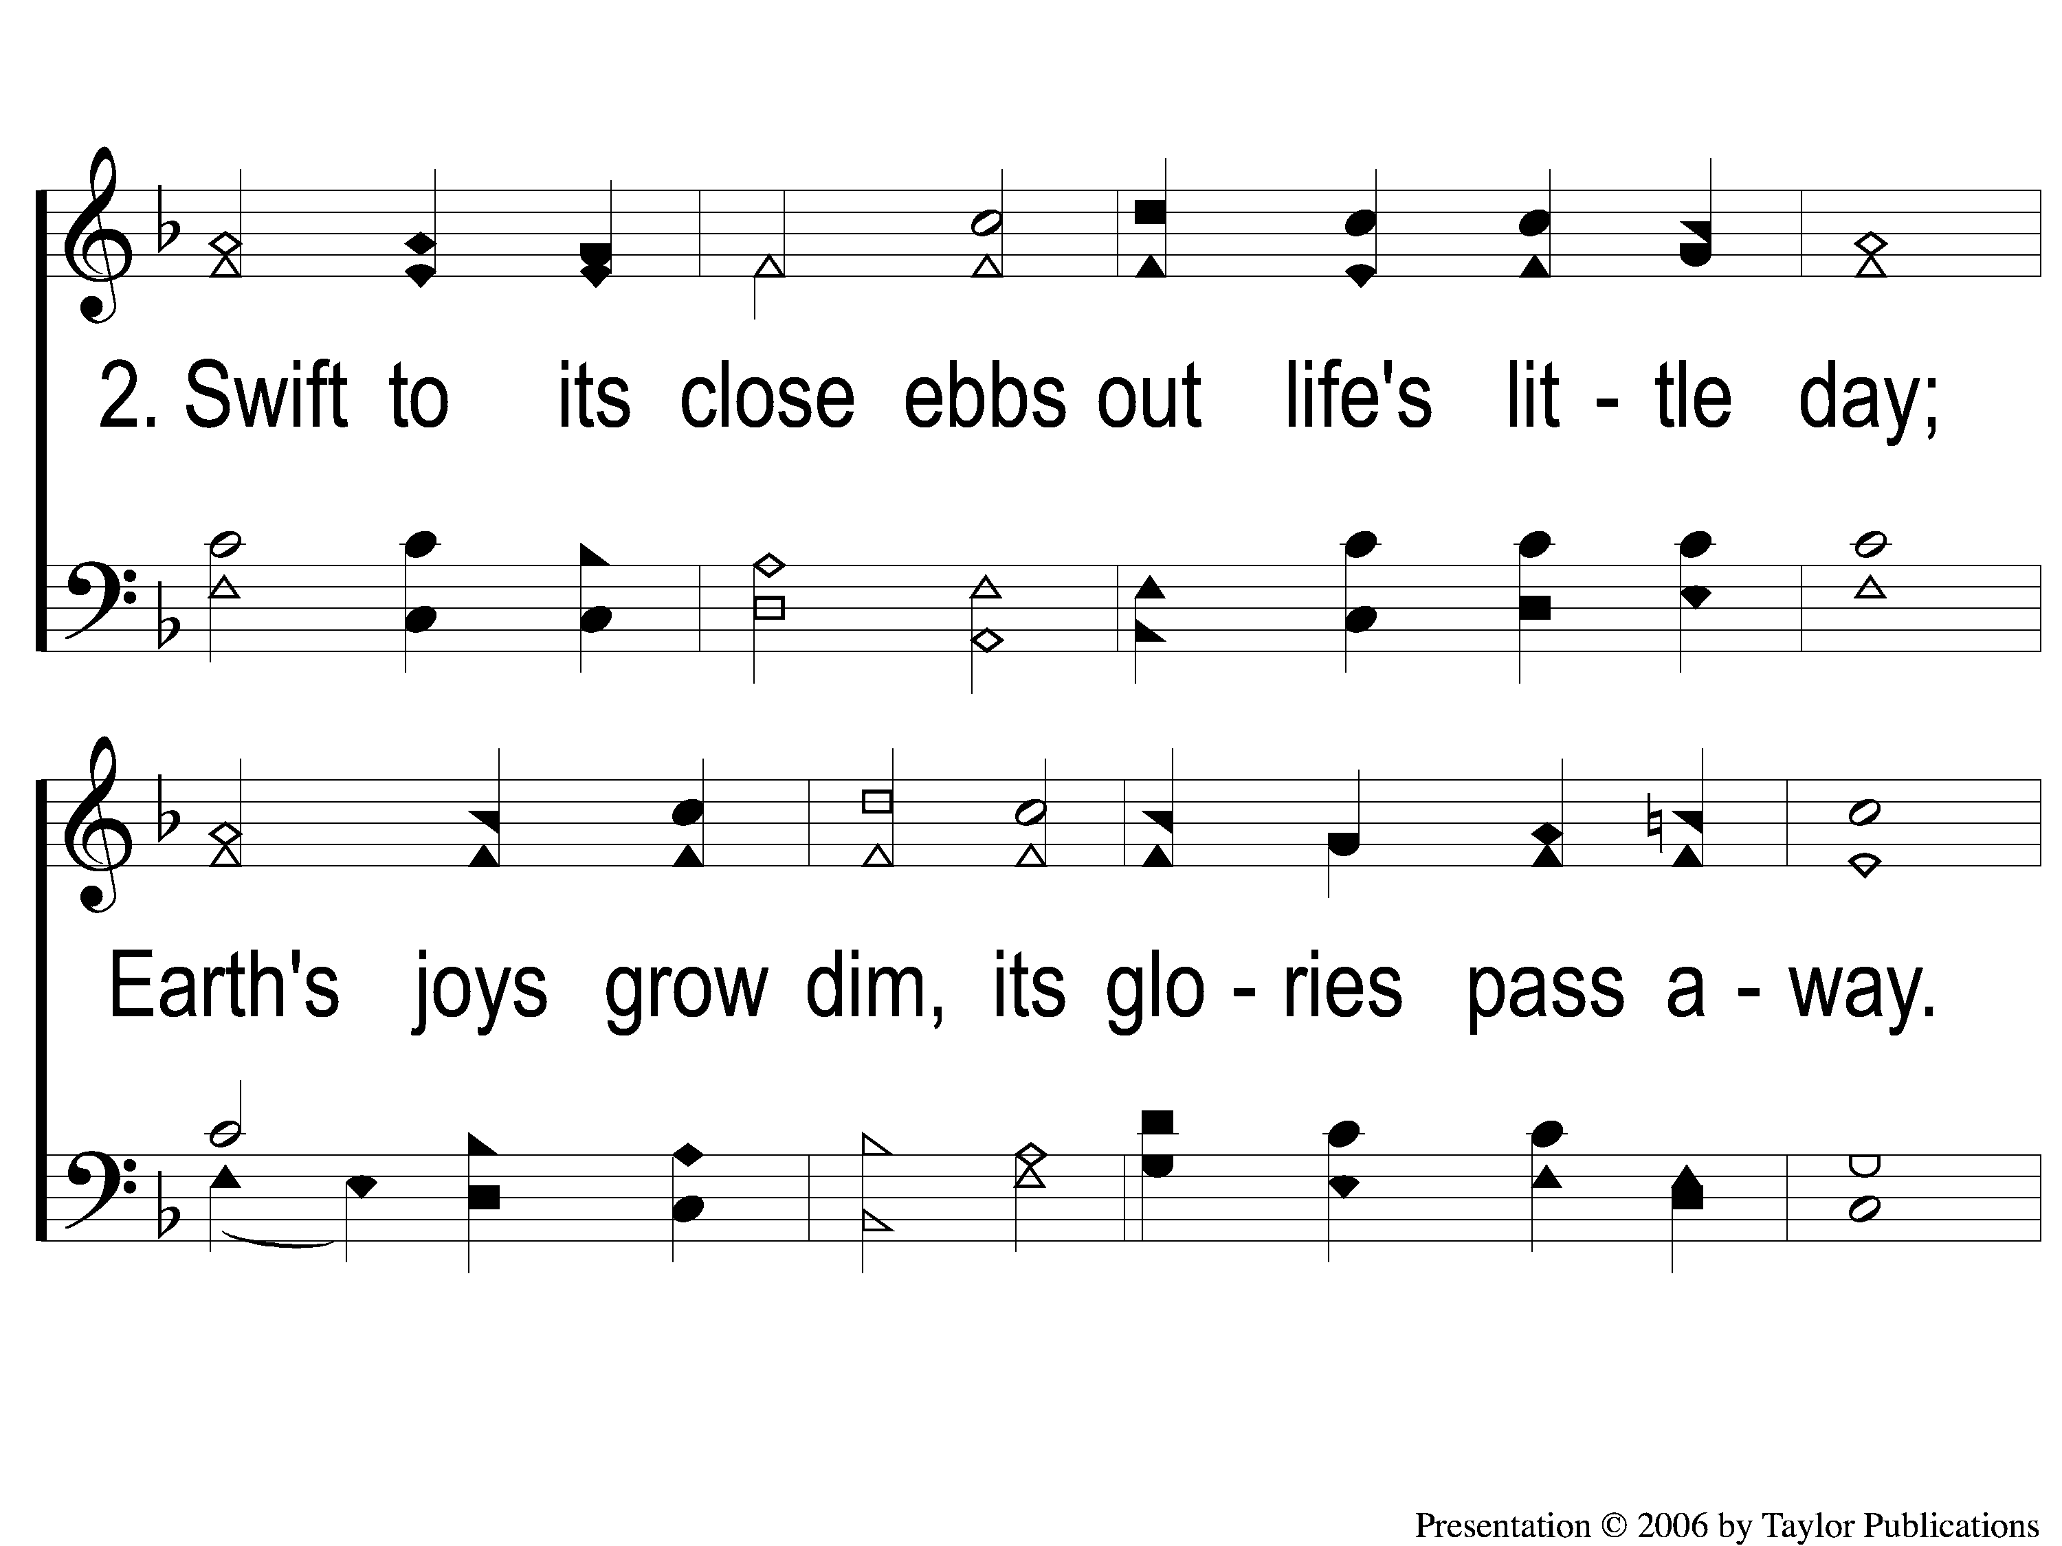
2-1 Abide with Me
Abide With Me
19

Slide 4
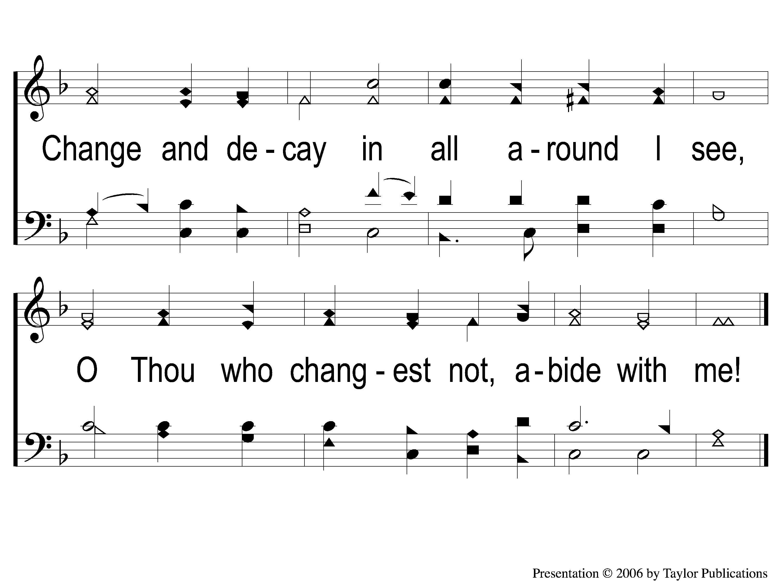
2-2 Abide with Me
Abide With Me
19

Slide 5
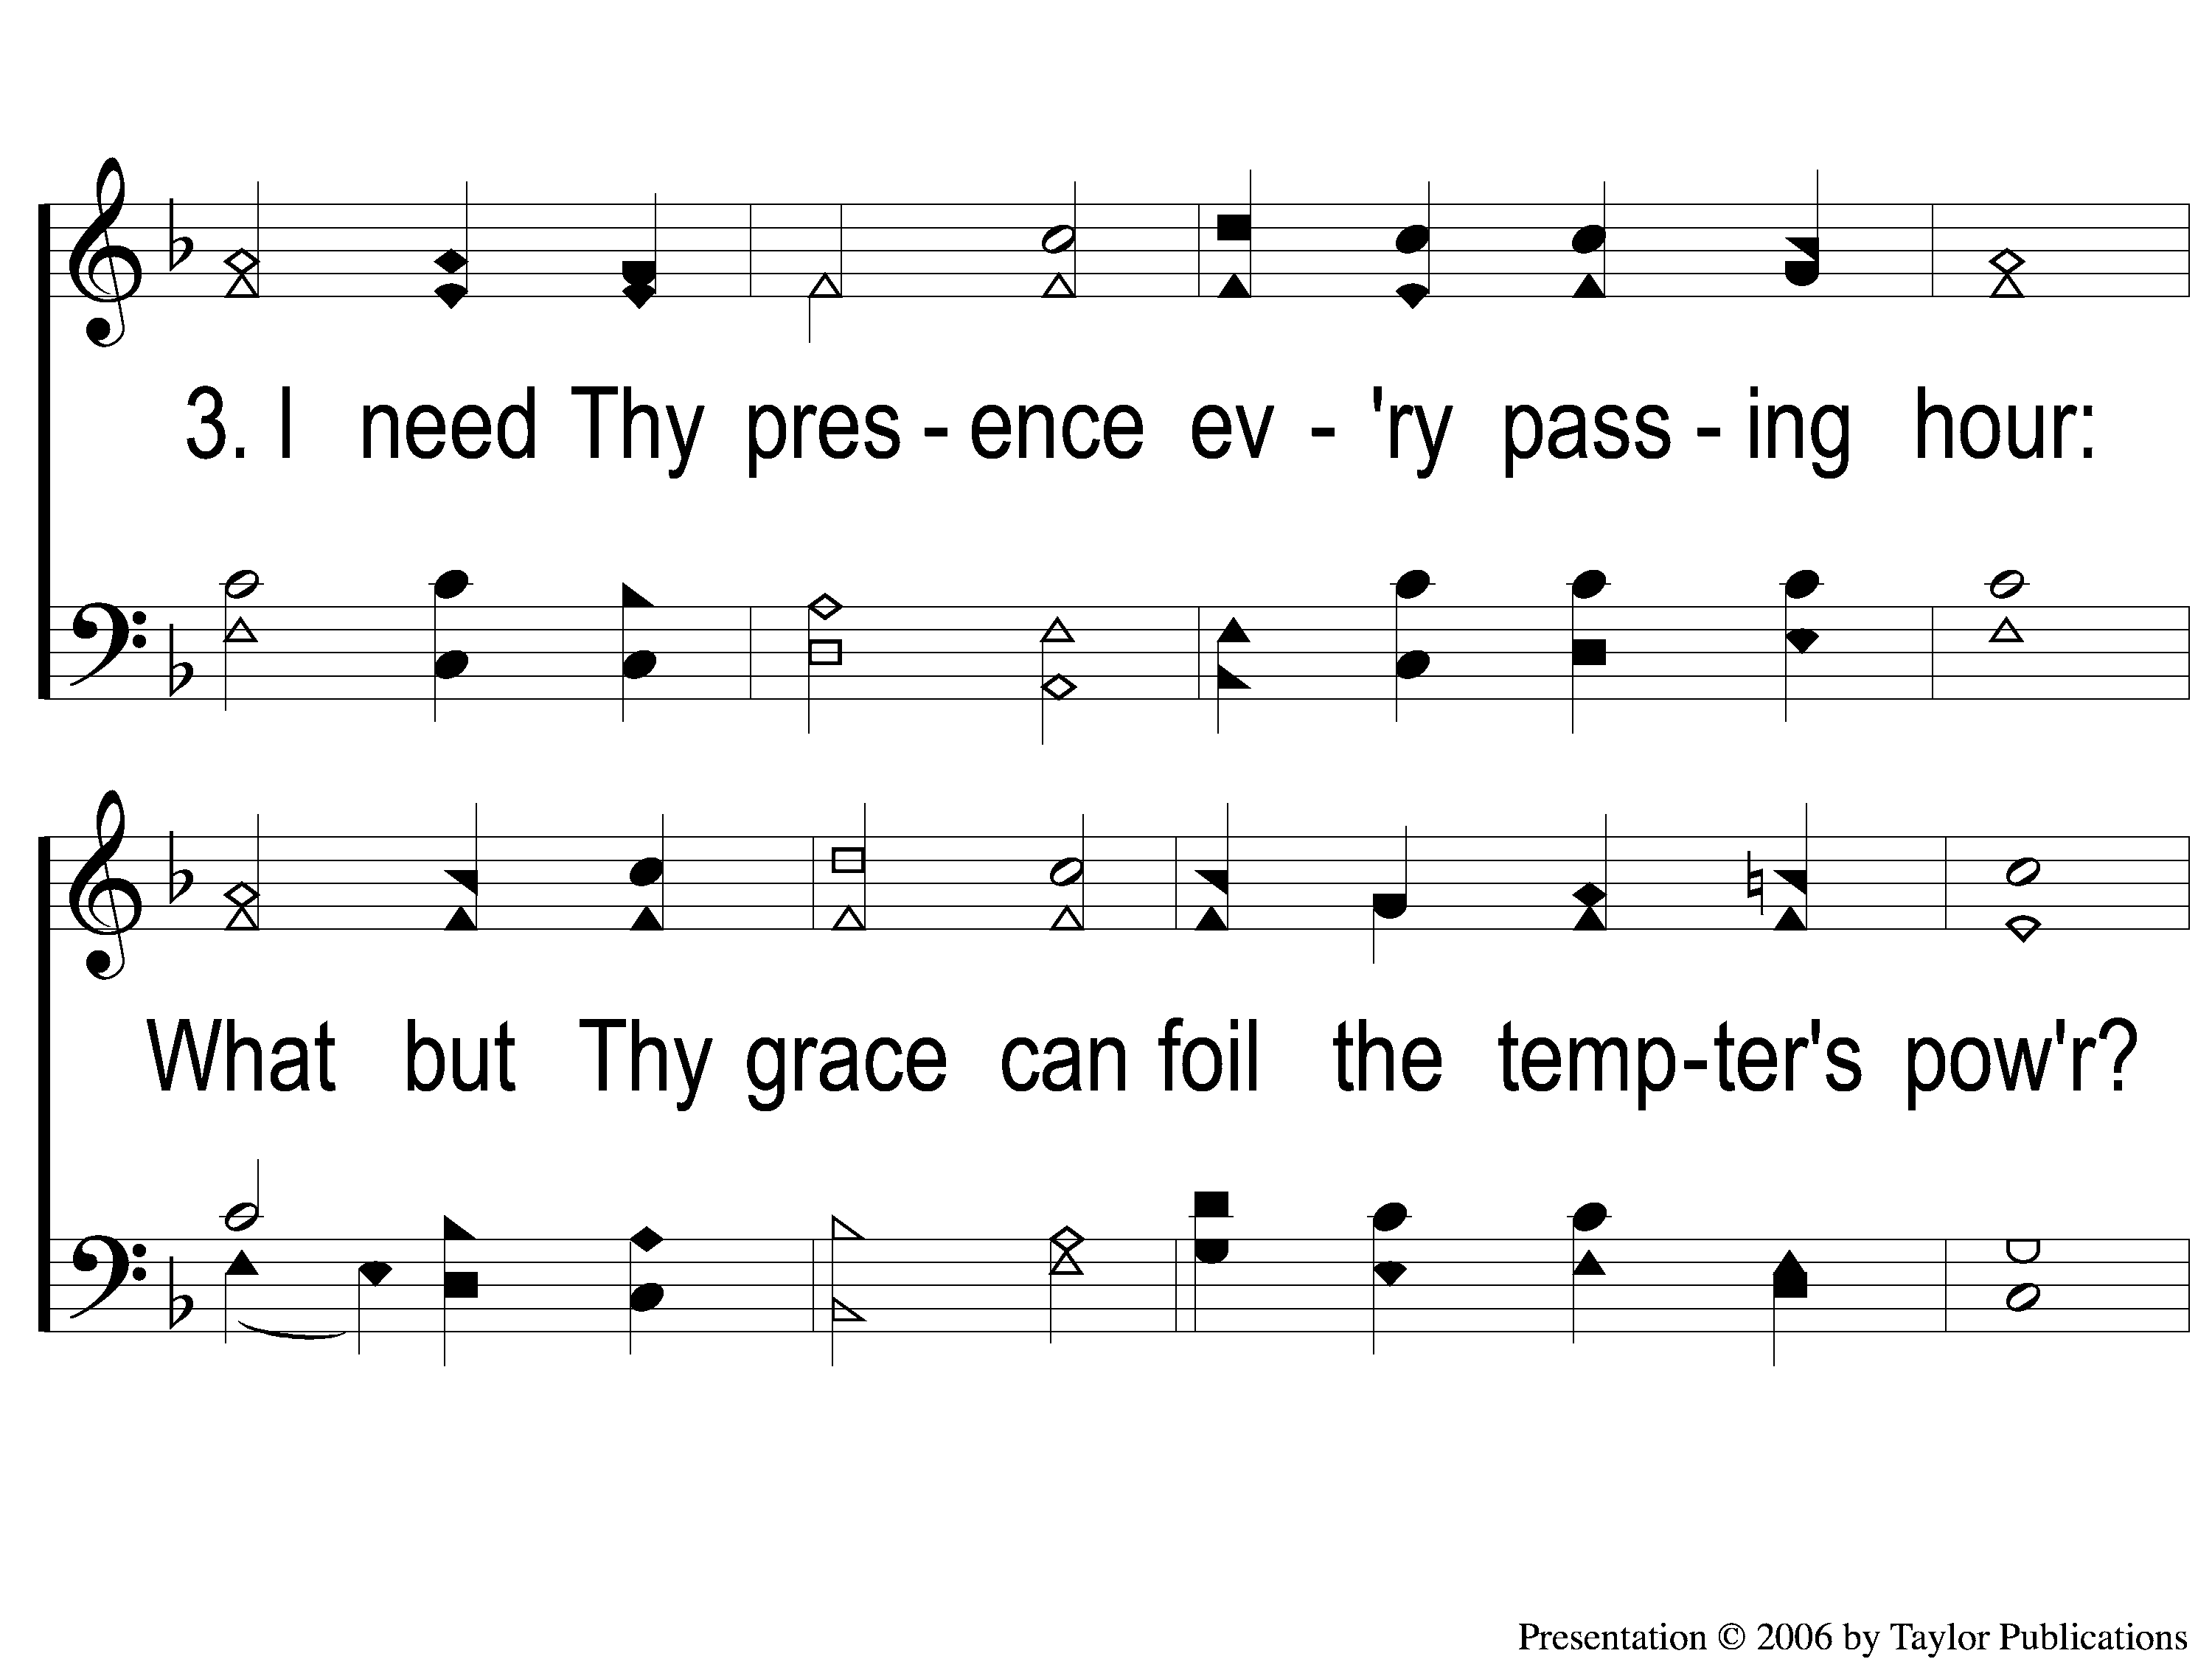
3-1 Abide with Me
Abide With Me
19

Slide 6
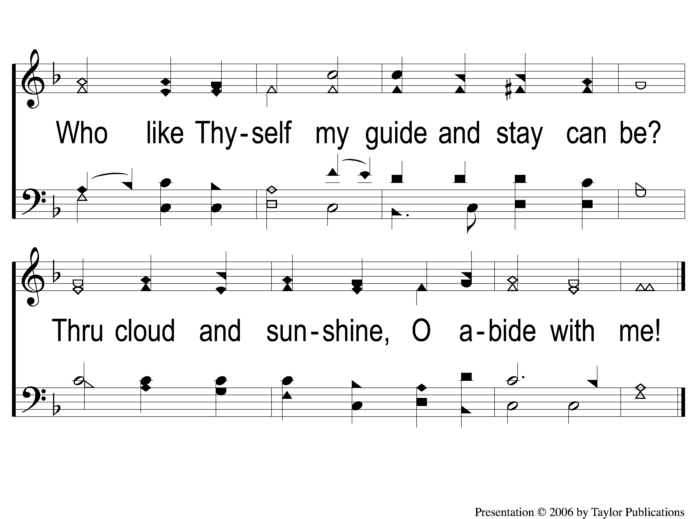
3-2 Abide with Me
Abide With Me
19

Slide 7
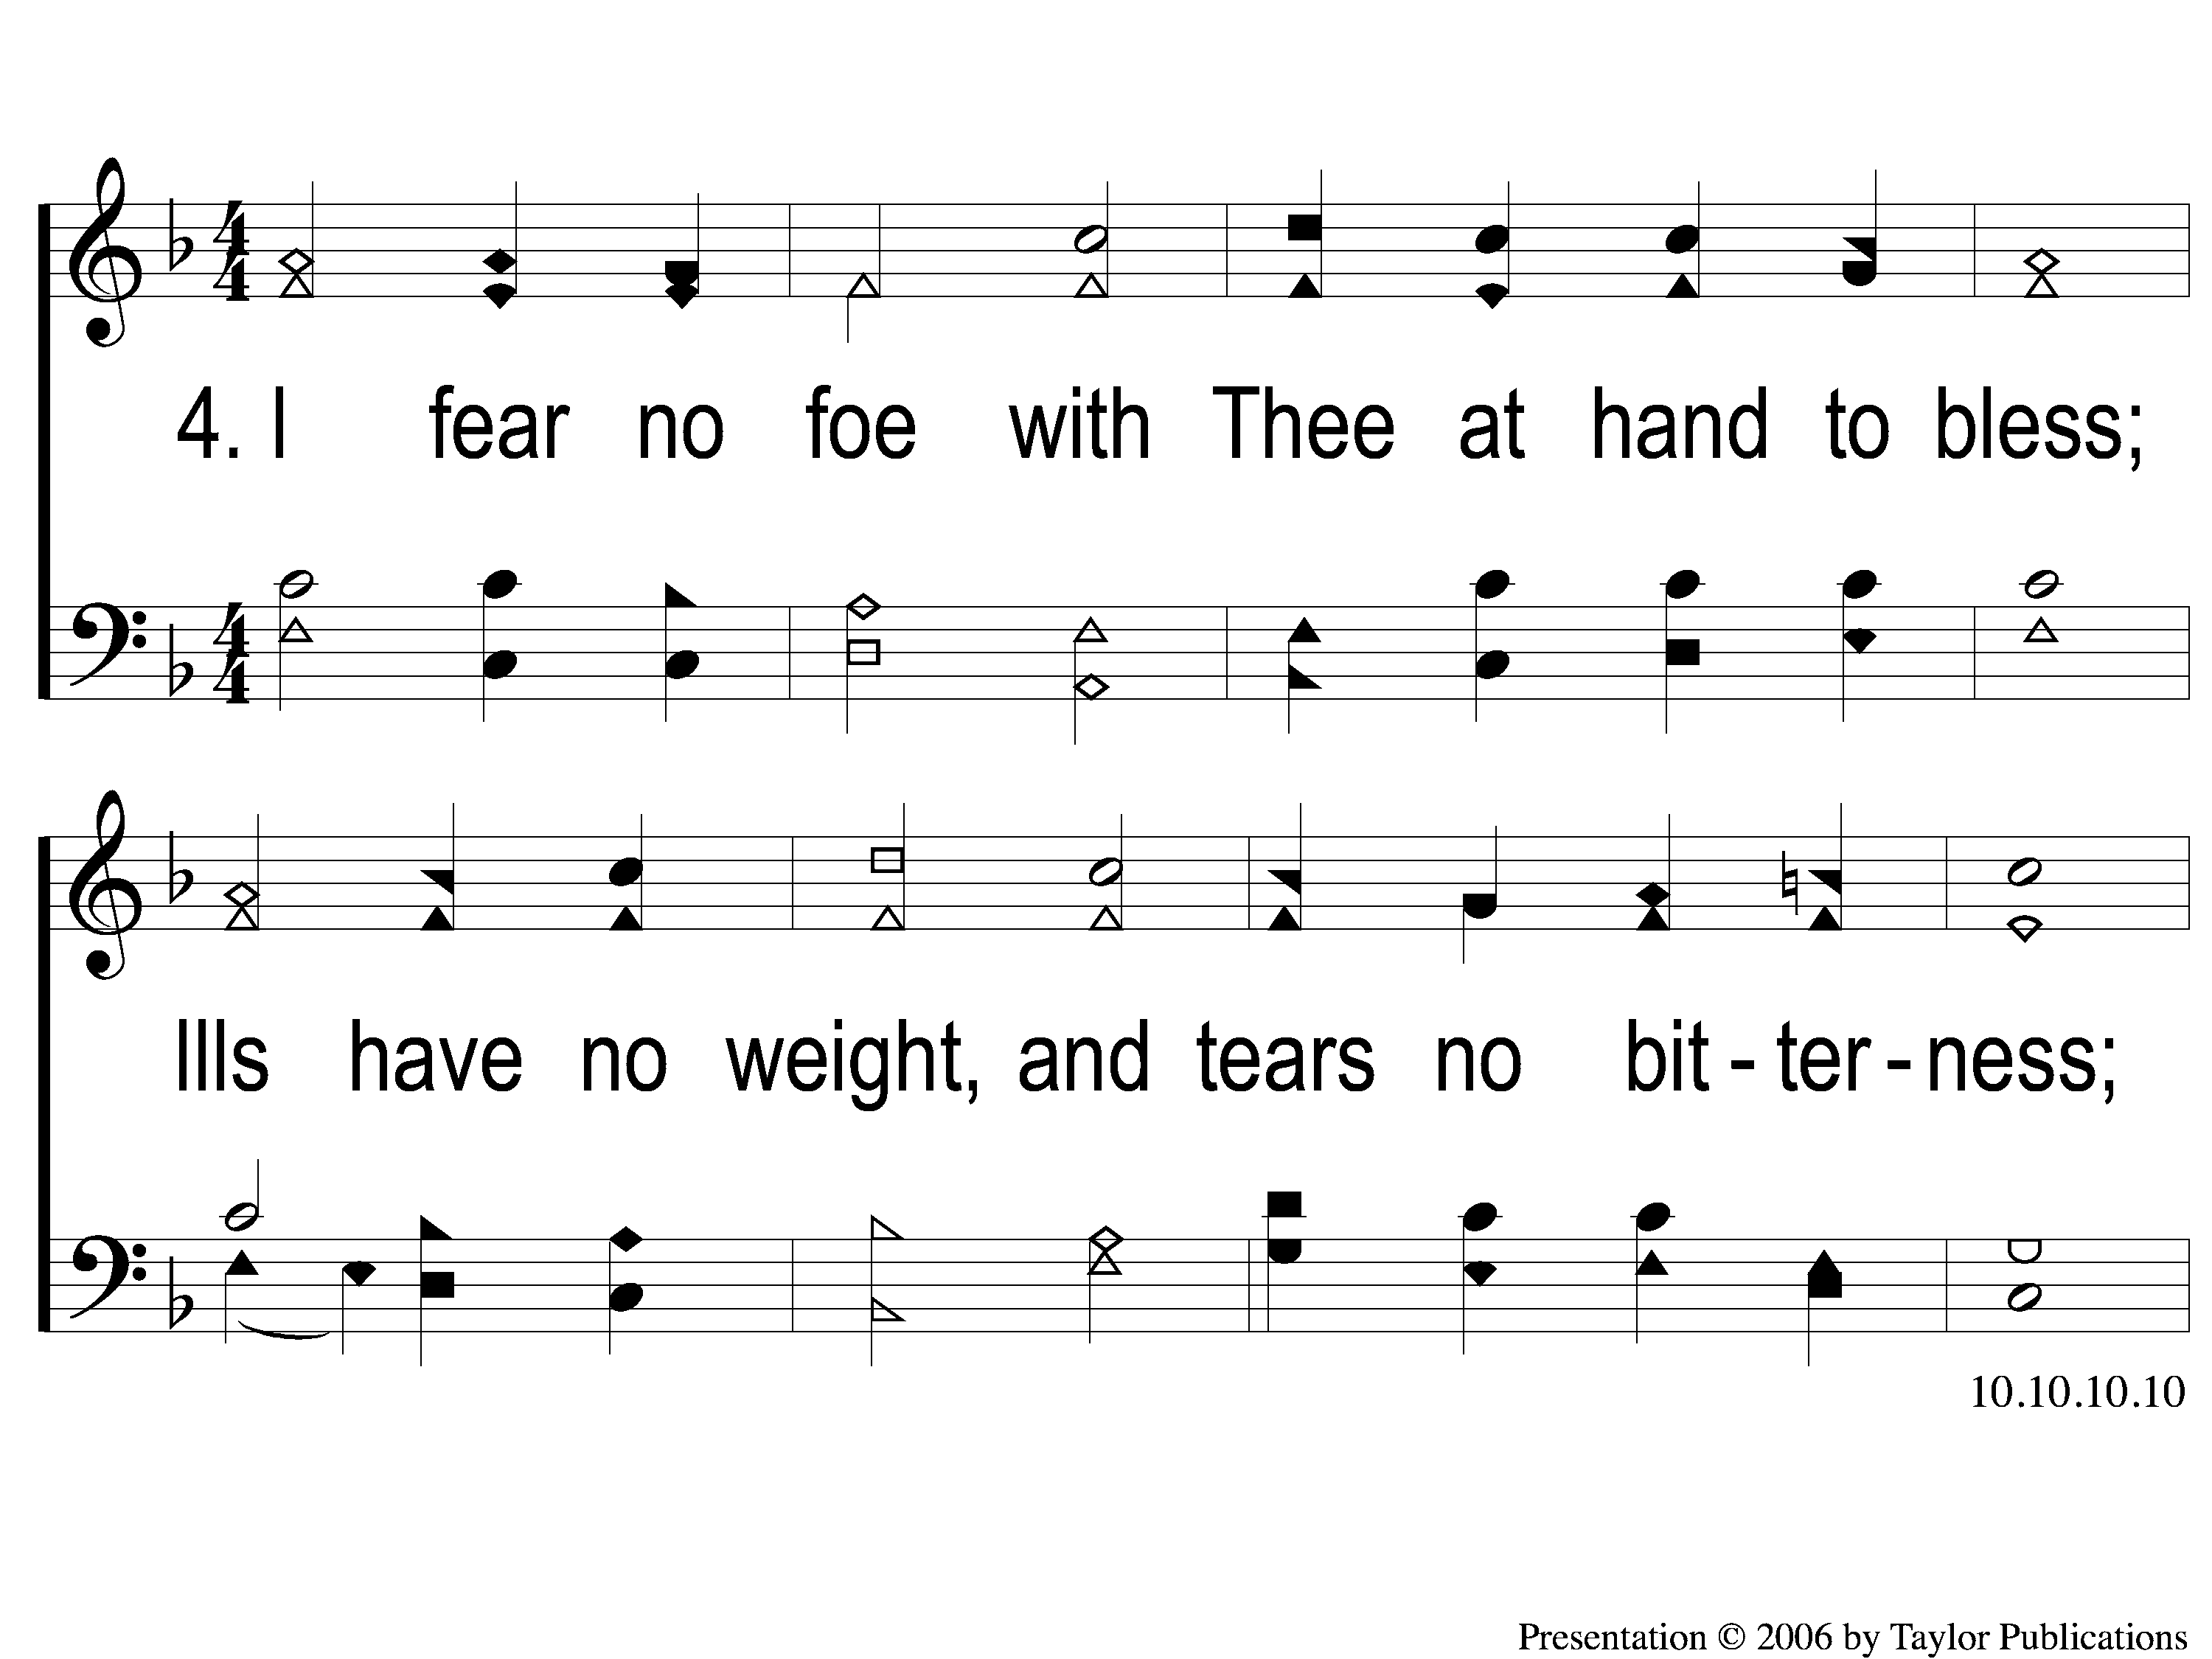
4-1 Abide with Me
Abide With Me
19

Slide 8
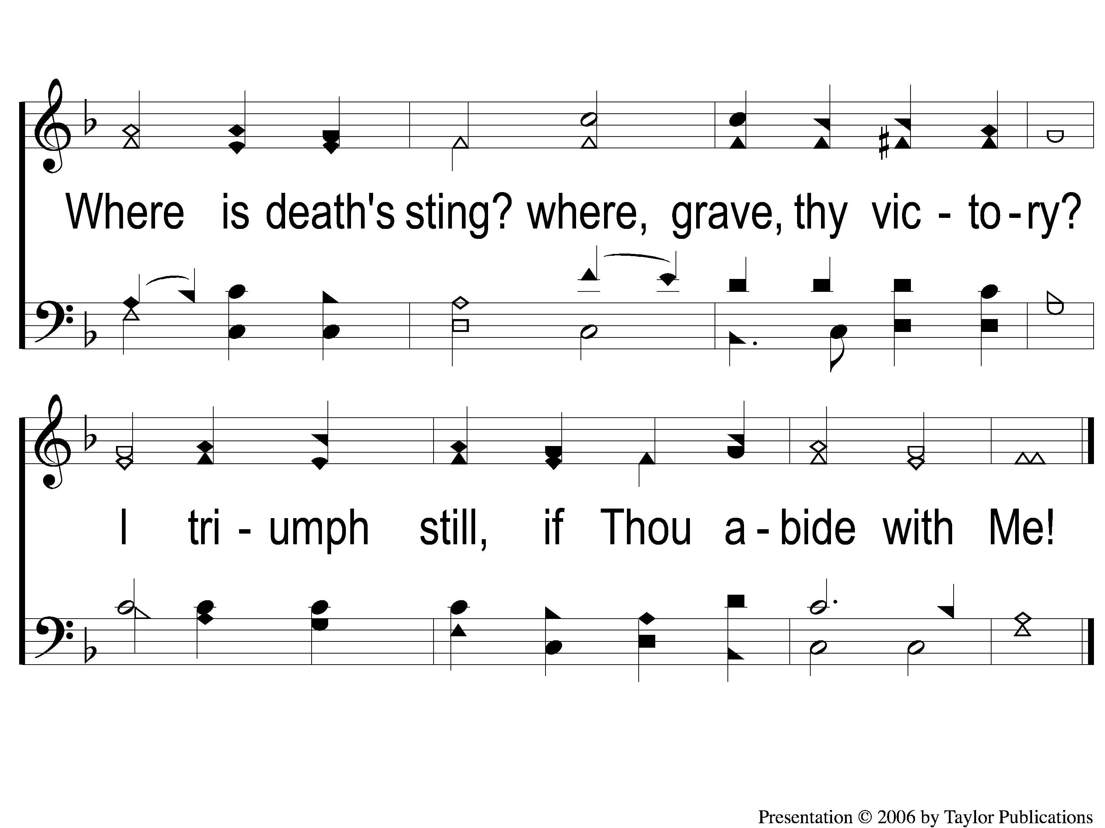
4-2 Abide with Me
Abide With Me
19

Slide 9
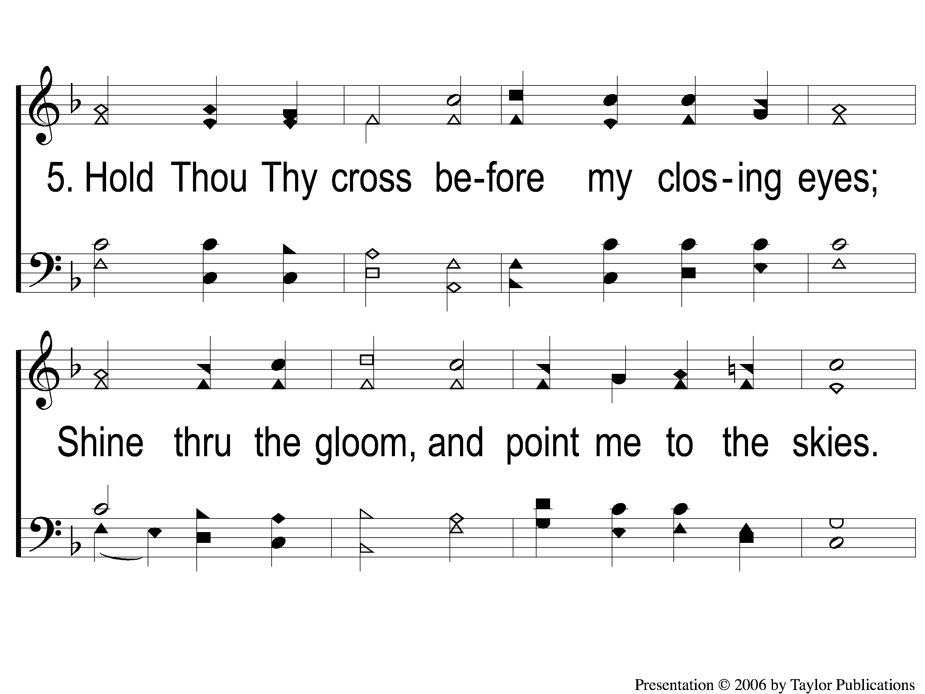
5-1 Abide with Me
Abide With Me
19

Slide 10
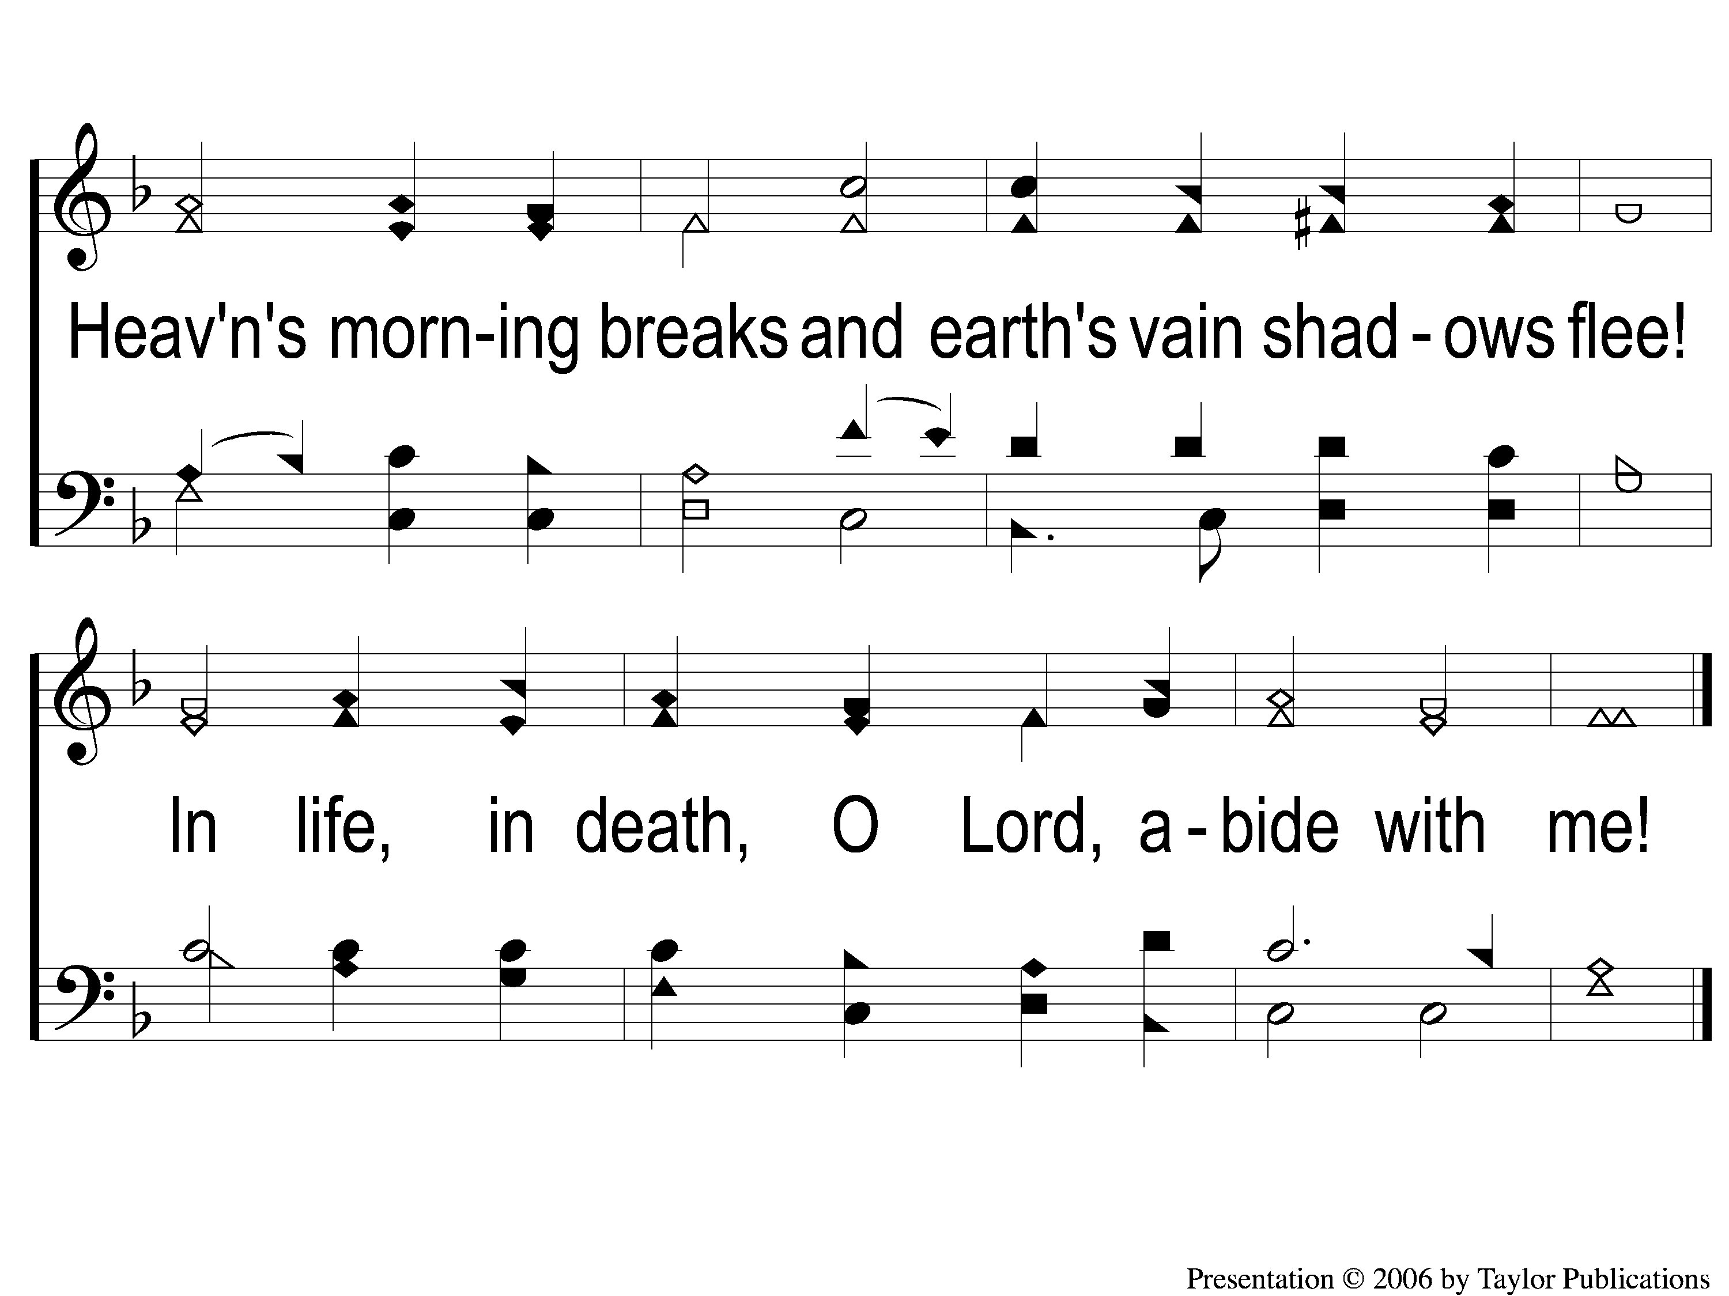
5-2 Abide with Me
Abide With Me
19

